Slide 1
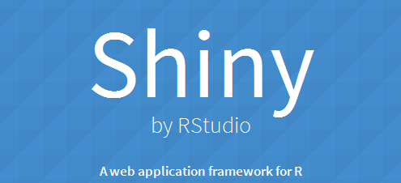
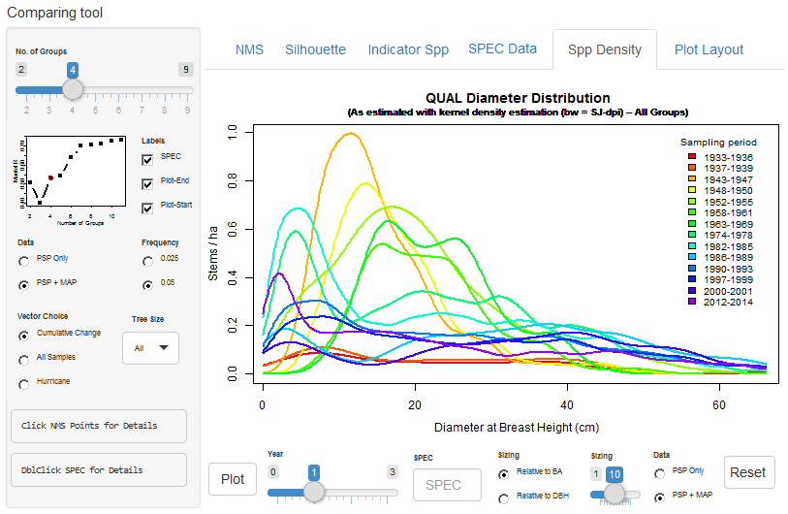
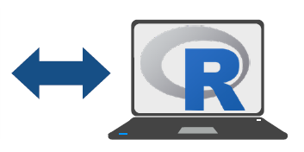


Intro to Shiny Workshop (No, really, you can learn this)
Install R & install/open RStudio
RUN: install.packages(“shiny”, repos=“http://cran.rstudio.com/”)
DO THIS
Download ppt @ www.theforestecologist.com/shiny
2017 Biology Symposium
Chris Payne
Curriculum For Environment & Ecology
UNC Chapel Hill
3 May 2017

Slide 2
Outline
Install R & install/open RStudio
RUN: install.packages(“shiny”, repos=“http://cran.rstudio.com/”)
What is Shiny?
Shiny Basics
Styling Shiny apps
Play with Code…

Slide 3
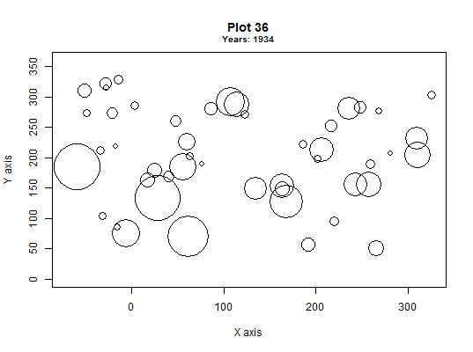

What is Shiny?
Install R & install/open RStudio
RUN: install.packages(“shiny”, repos=“http://cran.rstudio.com/”)
Not just any R package…
A web application framework for R
Turn your analyses into interactive web applications!
In other words:
Shiny lets you generate HTML with R
BORING!!
Colors

Slide 4
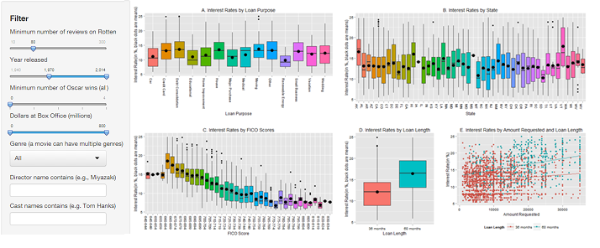
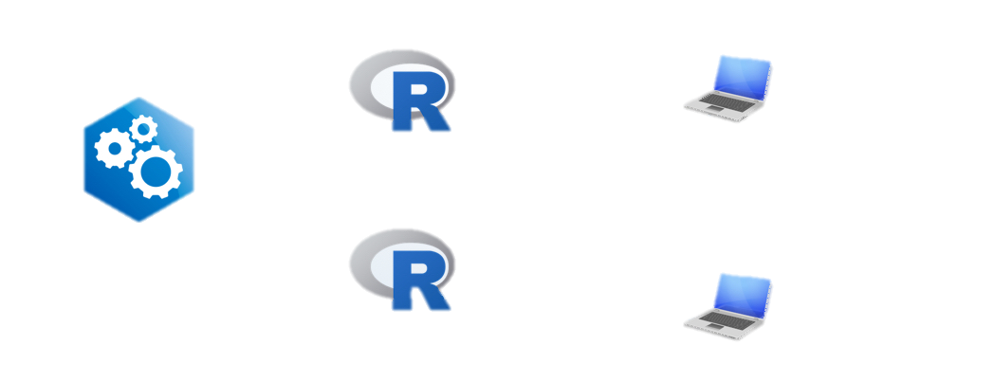

What Can Shiny Do For You?
Install R & install/open RStudio
RUN: install.packages(“shiny”, repos=“http://cran.rstudio.com/”)
Manipulative / interactive Exploratory Data Analyses
Good for complex data w/ many input variables
Share, Publish, and Educate!
Put your Shiny app on the web by using your own servers or Rstudio's hosting service.
R Process
End Users
Shiny Web App
A
R Process
Server
B

Slide 5
Basics
Install R & install/open RStudio
RUN: install.packages(“shiny”, repos=“http://cran.rstudio.com/”)
Shiny apps have 2 main components:
User-interface (UI) script
Server script
Essentially, a Shiny App = a web page (UI) connected to a computer (i.e., the Server) running a live R session.
Manipulating the UI causes the server to update the UI’s displays (by running R code).

Slide 6
Simple template
Install R & install/open RStudio
RUN: install.packages(“shiny”, repos=“http://cran.rstudio.com/”)
library(shiny)
ui <- fluidPage()
server <- function(input, output){}
shinyApp(ui = ui, server = server)
Load and attach Shiny package(s)
Create User Interface
Create server instructions
Combine UI and server code into functioning app
Note: UI and server code can be separate files or created/saved in 1 .R file
Notes:
The simplest Shiny App can be generated using these 4 simple lines of code.
Although this app is blank (empty), these same 4 lines can be used as a template to create any Shiny App.

Slide 7
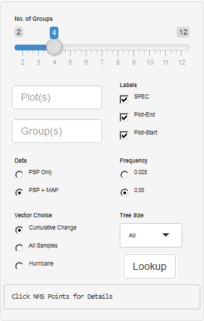
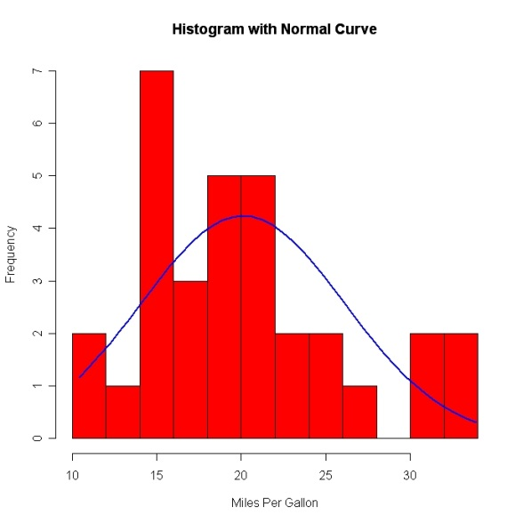
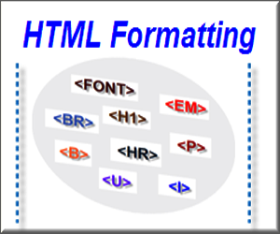
UI – User Interface
3 Major components:
Input (controls)
Checkboxes, sliders, drop-down menus, action buttons, etc.
Output Rendering
Graphs, tables, text, images, etc.
(Formatting / Styling )
HTML and/or CSS
Generally, created in server R code.

Slide 8
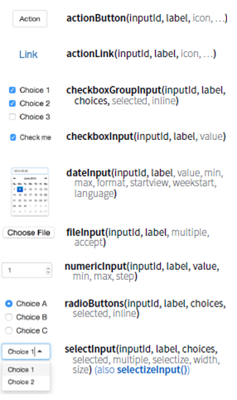
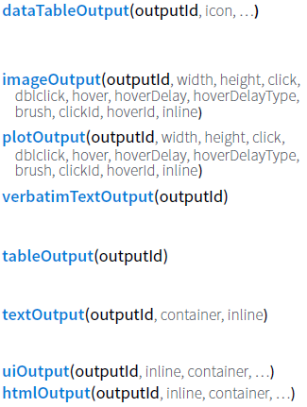
Inputs and Outputs
Access via ID names
inputId
&
outputId
Created in ui.R
Created in server.R
Inputs inform R code (Collect values from the user)
R code generates outputs
(Adds R output to UI)
Notes:
All inputs require an inputId and all output objects require an outputId. These IDs are how you reference input/output objects in your code.

Slide 9
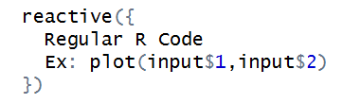
Server
Instructions on how to build and rebuild the R objects displayed in the UI
R code
+
Input values from UI
Creates Output objects
=
(For UI)
Made possible b/c input values are reactive
Utilize this reactivity using reactive() functions in server script
Surrounding any R code by reactive function allows function to be modified by UI input values

Slide 10
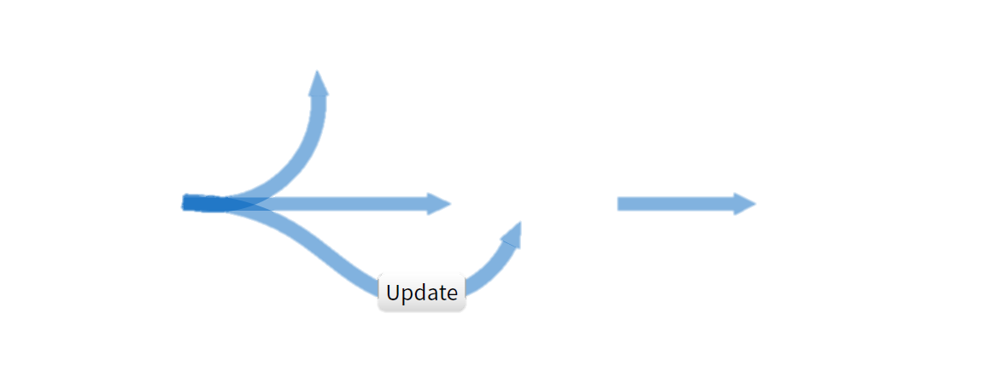
Reactivity
i.e., inputs + objects created from other reactive functions
Reactive values work together with reactive functions
Note: failure to use a reactive function results in an error
Trigger
arbitrary code
observeEvent()
observe()
Modularize
reactions
reactive()
Run(this)
Prevent reactions
isolate()
input$inputId
expression()
output$outputId
Render
reactive output
render*()
Create your own
reactive values
reactiveValues()
*Input()
Delay reactions
eventReactive()
Notes:
Conceptually, a reactive expression is a expression whose result will change over time.
In Shiny, objects or functions utilizing changing input values MUST be wrapped in a reactive() function to work!
Any expression that uses a reactive expression (i.e., due to being defined with a reactive({}) ) must be used inside a reactive context, such as another reactive() call or inside observe() or renderXXX(). You should also look at reactiveValues() function
Note: when referencing reactive objects:
- Dynamic input objects created in UI are referenced as input$inputID
- Reactive objects created using reactive() function are referenced as object_name()
-> I.e., you include parentheses following the reactive object’s name.
How to understand Reactivity in R: https://shiny.rstudio.com/articles/understanding-reactivity.html

Slide 11

General Workflow
User Interface
View output object
*Output()
Create your own
reactive values
*Input()
output$outputId
Render
reactive output
render*()
input$inputId
Modularize
reactions
reactive({ Rcode(input$inputId) })
Server
Notes:
All inputs require an inputId and all output objects require an outputId. These IDs are how you reference input/output objects in your code.
Note: You can choose to use an input object directly in a render function, as render functions are a type of reactive function!

Slide 12
So How Do I Make it Look Good?
We just reviewed the basics of how Shiny works
Turn our focus to appearance & styling
App Layout
Styling

Slide 13
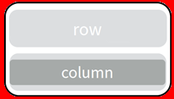
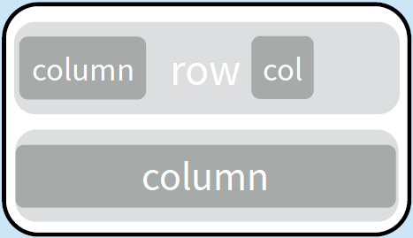
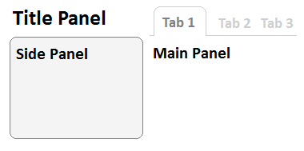
UI Layouts
fluidPage function creates display that automatically adjusts to the user’s device/browser dimensions
Place input/output layout elements as arguments w/in fluidPage function.
FluidPage layout consists of “rows” which in turn include “columns”
fluidRow & column = allow you to create/manipulate rows & columns
Common layout functions
titlePanel = creates title line
sidebarLayout = creates “default” layout
sidebarPanel = sidebar (e.g., for input controls)
mainPanel = main output area
Other useful function
tabsetPanel = create multiple tabs (“pages”)
Widths are defined/split by 12-unit wide grids
Learn more!
Notes:
Control specific rows and columns directly using fluidRow and column functions.
Because the output page is made dynamic using fluidPage(), you can’t assign widths of specific units (e.g., pixels or cm). Instead, the widths are defined by 12 unitless width units.
-> These “units” each represent 1/12 of the visible viewing screen
-> therefore, they represent relative amounts of width depending on screen size.
The column/row image represents a few examples:
Two 12-unit wide rows (light grey).
Bottom column is also 12-units wide.
Top two columns are 4 and 2 units wide, respectively, with a 3-unit wide space (i.e., “offset = 3”) between them.
CODE: fluidRow(column(width = 4), column(width = 2, offset = 3)), fluidRow(column(width = 12))

Slide 14
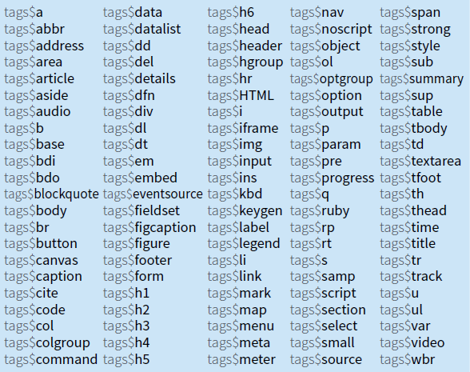
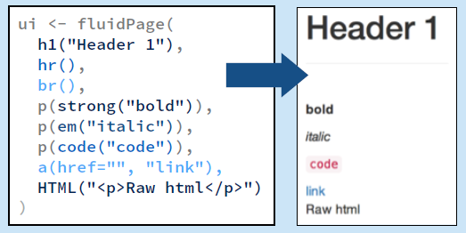
Customize your App’s Appearance
^{Style}
^
Add static HTML elements with tags, a list of functions that parallel common HTML tags
HTML tags = hidden keywords within a web page that define how a web browser formats & displays content
Ex: <div> </div> tag defines a division/section in an HTML document
The most common tags have wrapper functions.
Don’t need to prefix their names with tags$

Slide 15
Setting styles of individual elements
Setting the style of an HTML element can be done with the style attribute
tags$tagname( style = “property:value;” )
Example:
tag$p(“hello world”, style = "font-size:18px; color:blue;”)
Creates a paragraph of blue size-18 text saying Hello World
Notes:
Note that all property:value combos are split by semicolons (;) and that all styll properties are held within quotes.

Slide 16
CSS – “Advanced” Styling
CSS = Cascading Style Sheets
Is a style language used for describing how HTML elements are to be displayed
Note: the Shiny app user-interface (UI) is an HTML document
3 Approaches
Inline - by using the style attribute in HTML elements
Applies a unique style to that single HTML element
Internal - by using a <style> element in the <head> section
Defines a style for an entire HTML page
External - by using an external CSS file
Defines the style for (one or) many HTML pages!
Learn more!!
Add directly to .R script file(s)
Save as .css file to be called by app
Notes:
All of these approaches work in Shiny apps

Slide 17
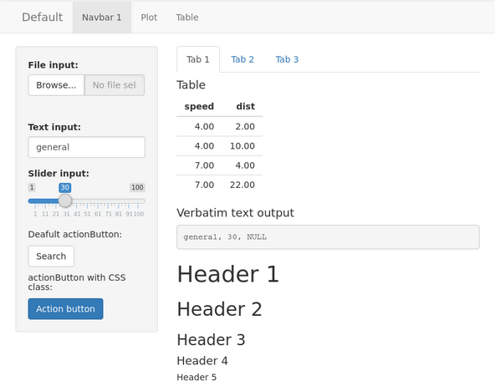
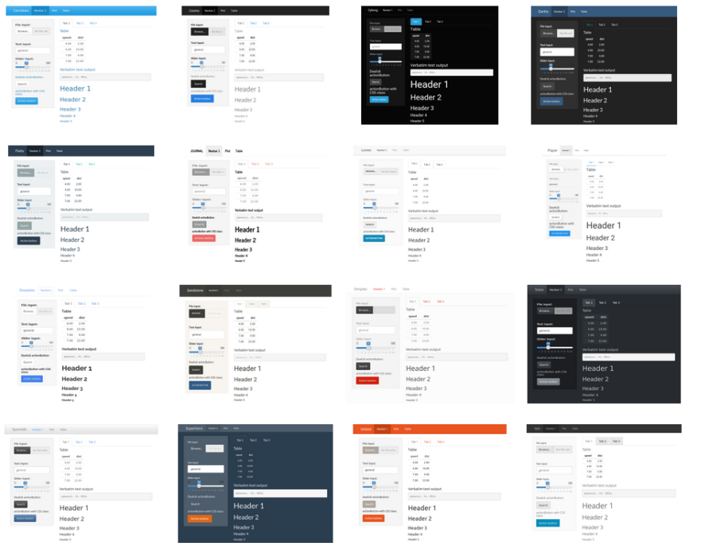
Themes
The overall theme of an app can be changed
vs 1 html line at a time
Default = “Bootstrap” theme
The shinythemes package lets you change app themes:
library(shinythemes)
ui <- fluidPage(..., theme = shinytheme("name"))

Slide 18
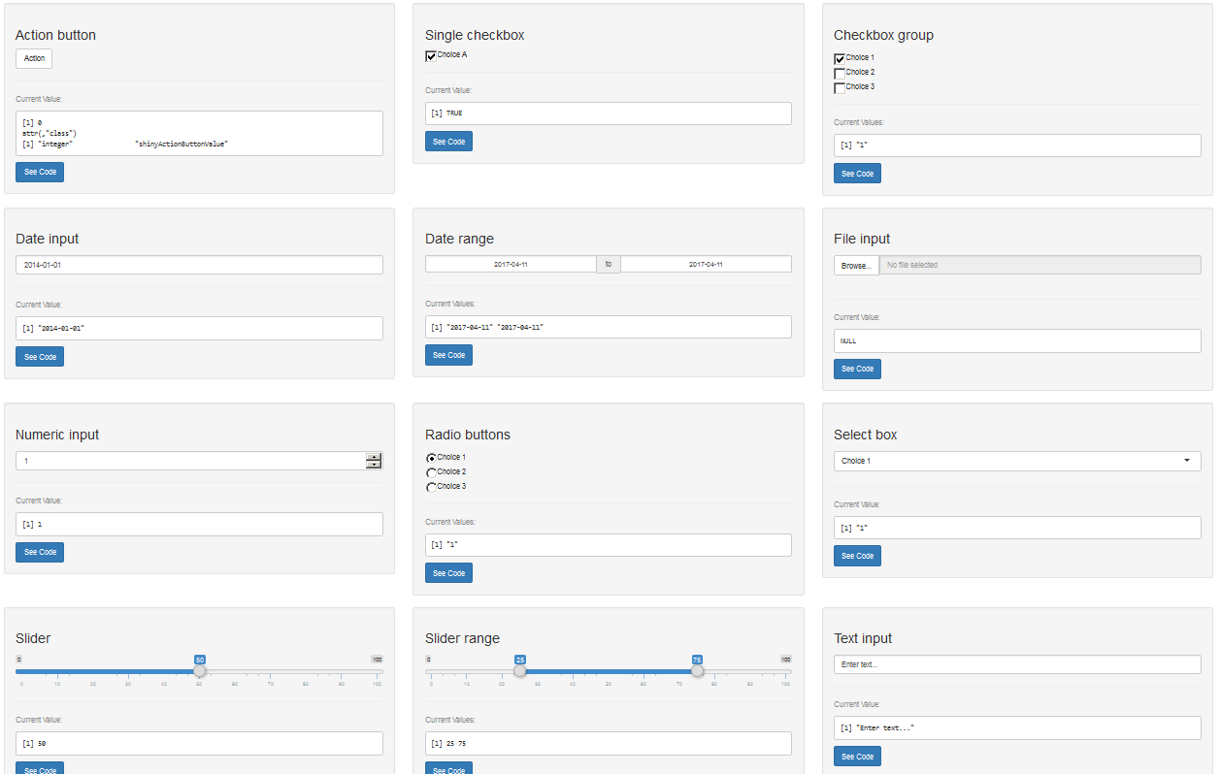
Useful Links
Cheat Sheet: the go-to Shiny reference!
Tutorials: videos, pdf’s, and example code
Widget Gallery: get to know the widgets
HTML Tags Glossary: learn how to use HTML tags
Showcase: complex / well-done Shiny examples

Slide 19
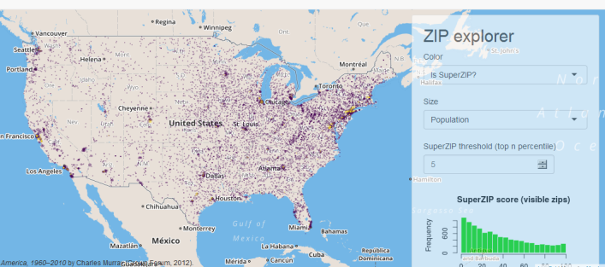
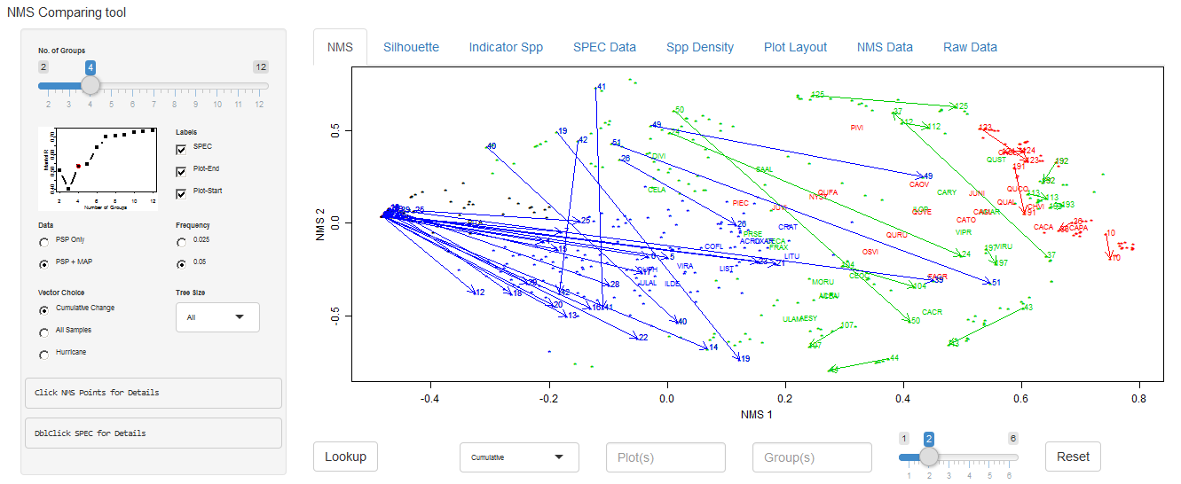
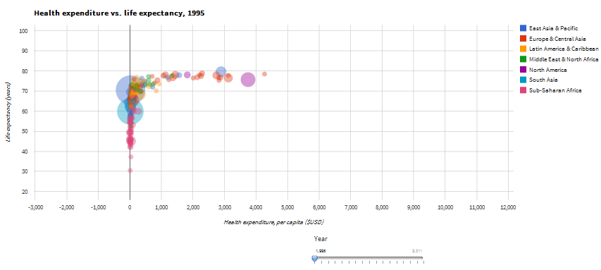
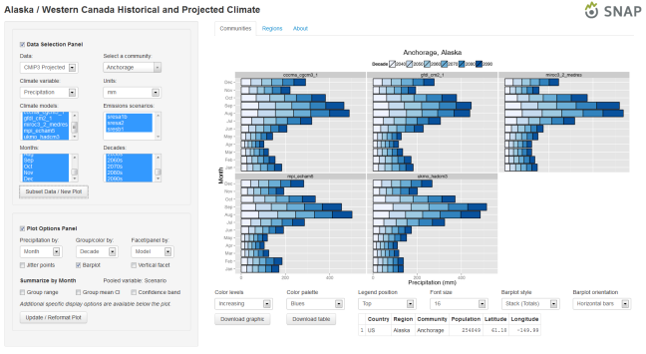
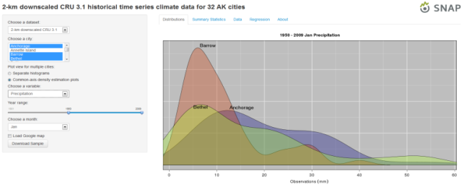
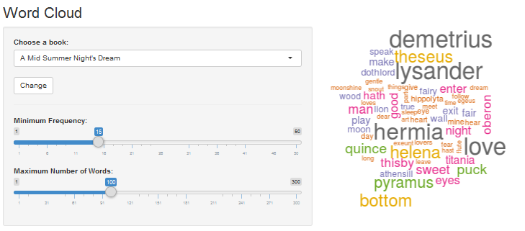
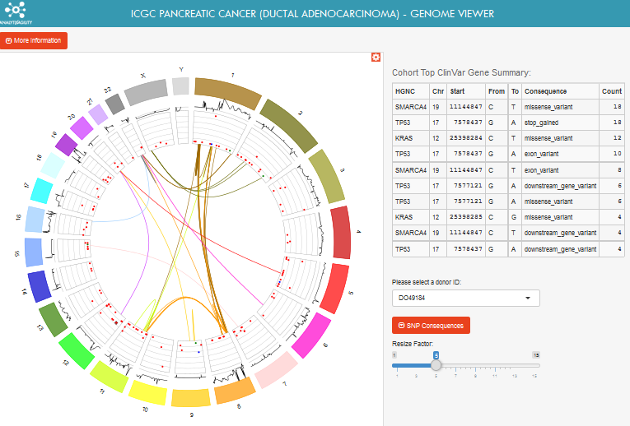
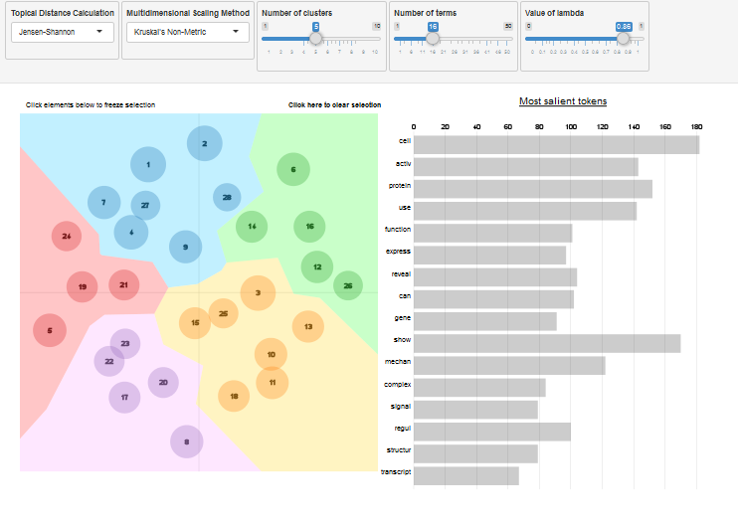
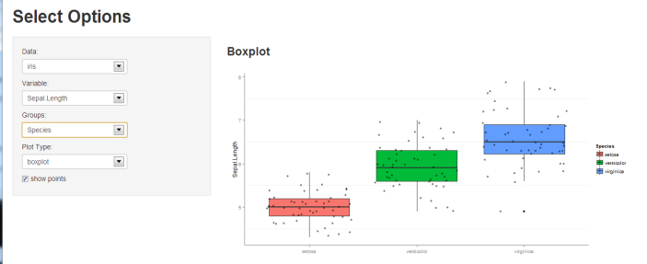
Endless Possibilities!!!

Slide 20
Endless Possibilities!!!
Takeaways?
Very beneficial for EDA & data viewing
Easy to learn
No really…
You should be able to apply to your own data with functional results in 1-2 days!

Slide 21
Let’s Jump Into Some Code!!!
Notes:
https://theforestecologist.shinyapps.io/IntroToShinyWorkshop/
(site will be offline until day of workshop)

Slide 22
Let’s Jump Into Some Code!!!
3 Ways to Follow Along:
Run it with me! (Preferred)
Paste the code found here into RStudio:
http://www.theforestecologist.com/shiny/
Online (ShinyApps.io)
https://theforestecologist.shinyapps.io/IntroToShinyWorkshop/
PDF
Run all but last command from #1 and open .pdf file.
Notes:
https://theforestecologist.shinyapps.io/IntroToShinyWorkshop/
(site will be offline until day of workshop)

Slide 23
Common Errors:
"Error in tag("div", list(...)) : argument is missing, with no default“
Likely means you have an "empty" (extra) comma somewhere...
"Error in .getReactiveEnvironment()$currentContext() : Operation not allowed without an active reactive context. (You tried to do something that can only be done from inside a reactive expression or observer.)“\
You forgot to place an input value (i.e., input$inputId) or object previously created using a reactive function inside of a reactive function (e.g., reactive({}) or render*({}))

